Slide 1
iFood's CRM Campaign Analysis
Dec/ 2020
LEONARDO MEIRELES

Slide 2
SUMMARY
Introduction
01
This presentation will follow these four major topics, in which the key takeaways from the study case will be discussed.
02
Customer Analysis
Customer Segmentation
03
04
Assertive Model

Slide 3
INTRODUCTION
Recently the company assessed that our profit growth for the next 3 years was not promising, concerned about this fact different strategies and ideas were discussed to overcome this bump in the company's growth. This presentation will be focusing on the strategies created to improve the marketing team's performance in marketing campaigns. To the right, we evaluate the last campaign's performance which in this case was not very successful.
-45%
RETURN ON INVESTMENT (ROI)
15%
SUCCESS RATE
Only 15% of customers accepted the campaign.

Slide 4
ROOM FOR IMPROVEMENT
Assessing last campaign's performance, it's noticeable that there is a need to improve the marketing campaign's strategy and the marketing team's decision making.
WHO ARE THE RESPONDENTS?
WHAT IS THEIR BUYING BEHAVIOUR?
IS IT POSSIBLE TO IDENTIFY THEM?

Slide 5
CUSTOMER ANALYSIS
THOROUGH EXPLORATORY DATA ANALYSIS OF CUSTOMER'S HISTORICAL DATA;
BUYING BEHAVIOUR ANALYSIS;
CUSTOMER PROFILING OF RESPONDENTS.

Slide 6
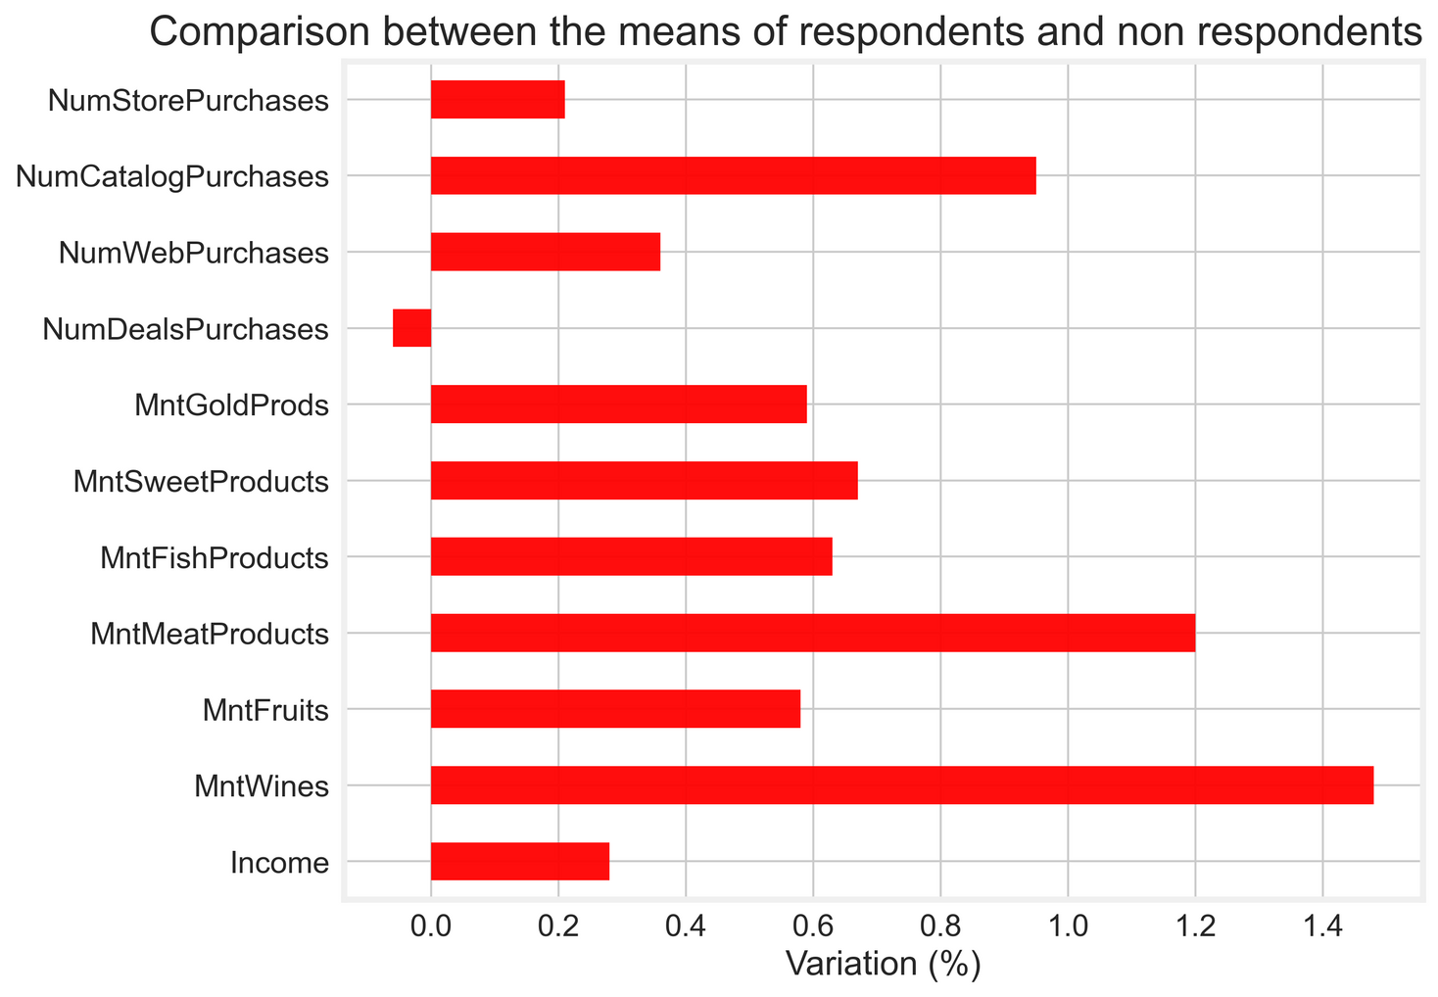
BUYING BEHAVIOUR
In general, respondents were more active and usually spent greater values in each category;
They used almost twice the catalog channel as the non-respondents;
Over the past two years, they spent 148% more on wine products that the non-respondents.

Slide 7
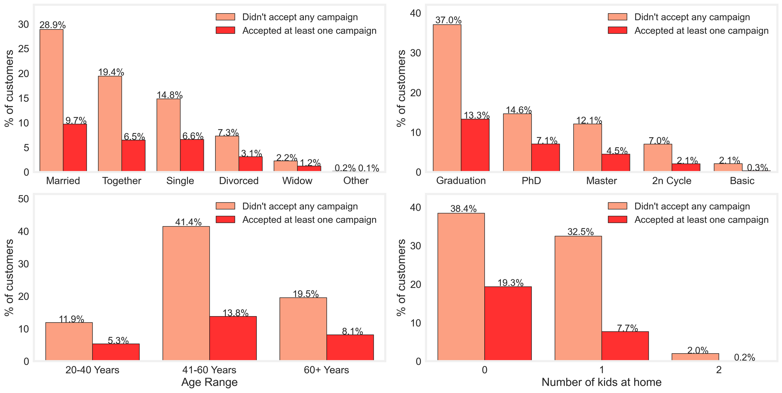
RESPONDENT'S PROFILE
The majority lives with a partner;
41-60 Years is the most susceptible age group.
Most of them have higher education;
Usually they don't have kids or teens at home.

Slide 8
CUSTOMER SEGMENTATION
A segmentation with an unsupervised learning technique using our customer's Recency, Frequency, and Monetary (RFM) values was proposed. The goal is to segment our customers into different groups based on their RFM values and find the segment with the best customers (which in this case also seem to be the respondents).
CONTACT ONLY SEGMENTS WITH HIGHER VALUES
FIND THE BEST CUSTOMERS
IMPROVE OUR CAMPAIGN'S PERFORMANCE

Slide 9
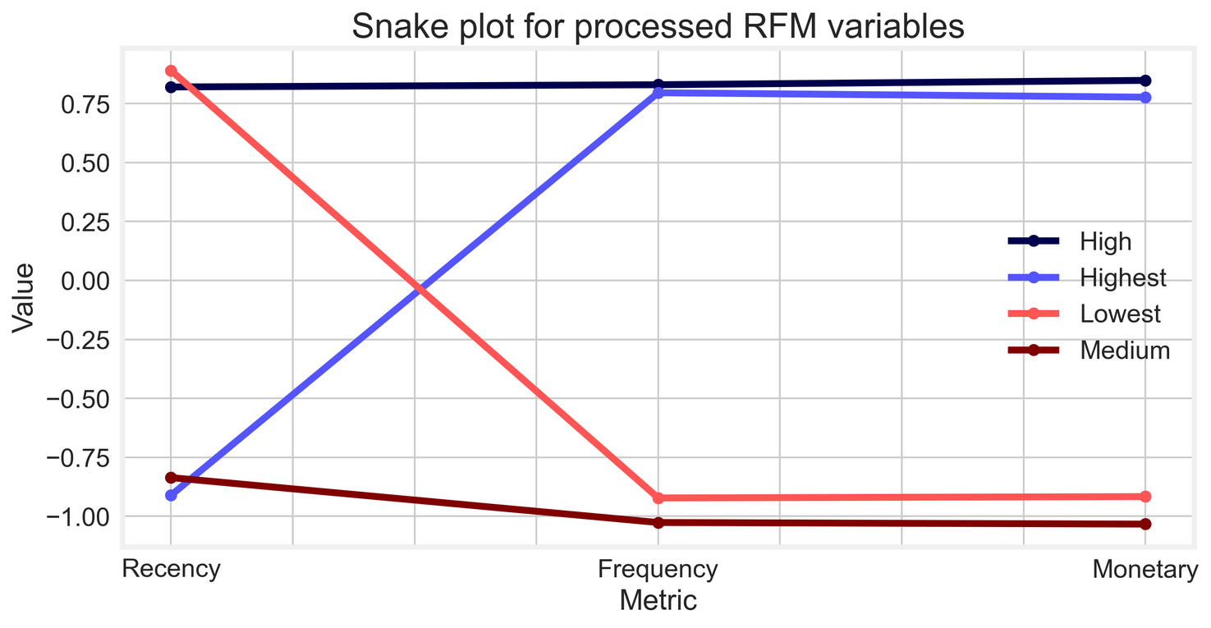
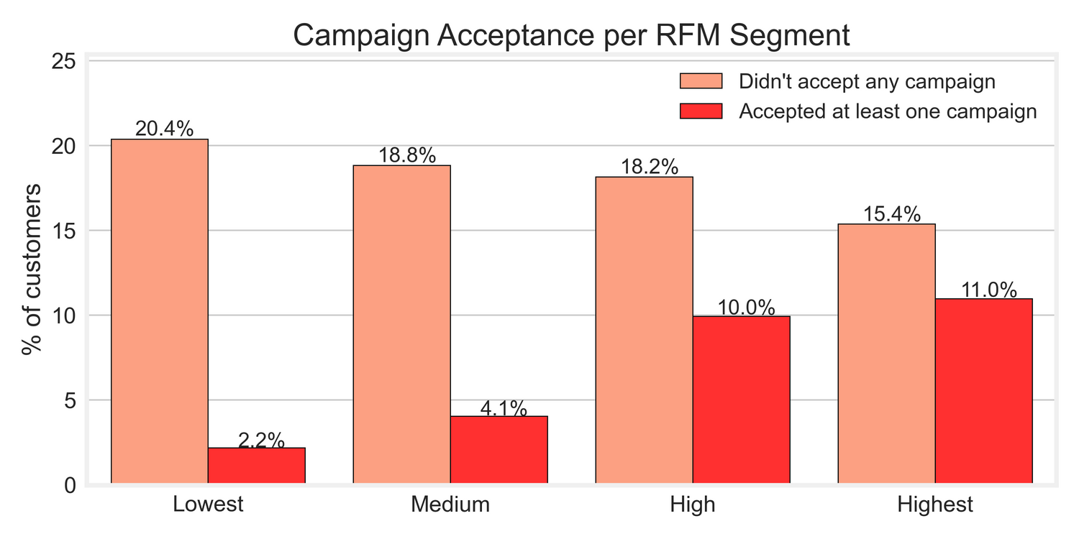
SEGMENTS
Four customer segments were found:
Lowest: High Recency and lower Frequency and Monetary values;
Medium: Low Recency, Frequency, and Monetary values;
High: High Recency, Frequency, and Monetary values;
Highest: Low Recency and higher Frequency and Monetary values.
Most of the respondents seem to be in higher customer segments;
The better our customers are, the more susceptible they are to marketing campaigns.

Slide 10
RFM STRATEGY
A simple approach to improve the results of the last campaign would be to contact only the High and Highest customer segments as they are more likely to accept the campaign. To the right, we can see the improved results if the marketing team only contacted customers in these segments.
HIGH AND HIGHEST
HIGHEST
-26%
-0.03%
-3%
RETURN ON INVESTMENT (ROI)
RETURN ON INVESTMENT (ROI)
RETURN ON INVESTMENT (ROI)
20%
27%
SUCCESS RATE
SUCCESS RATE
Only 20% of customers contacted accepted the campaign.
27%
Only 27% of customers contacted accepted the campaign.
SUCCESS RATE
1221
591
Only 27% of customers contacted accepted the campaign.
CUSTOMERS CONTACTED
CUSTOMERS CONTACTED
GREAT START BUT LET'S DO BETTER!

Slide 11
ASSERTIVE MODEL
Through the use of machine learning a model able to predict whether a customer will accept a marketing campaign or not was developed. The model was used as a tool to improve the marketing team decision making to contact or not different customers, reducing the total cost contact and increasing the marketing campaign ROI and success rate.
FEATURE SELECTION
MODEL SELECTION
MODEL EVALUATION

Slide 12
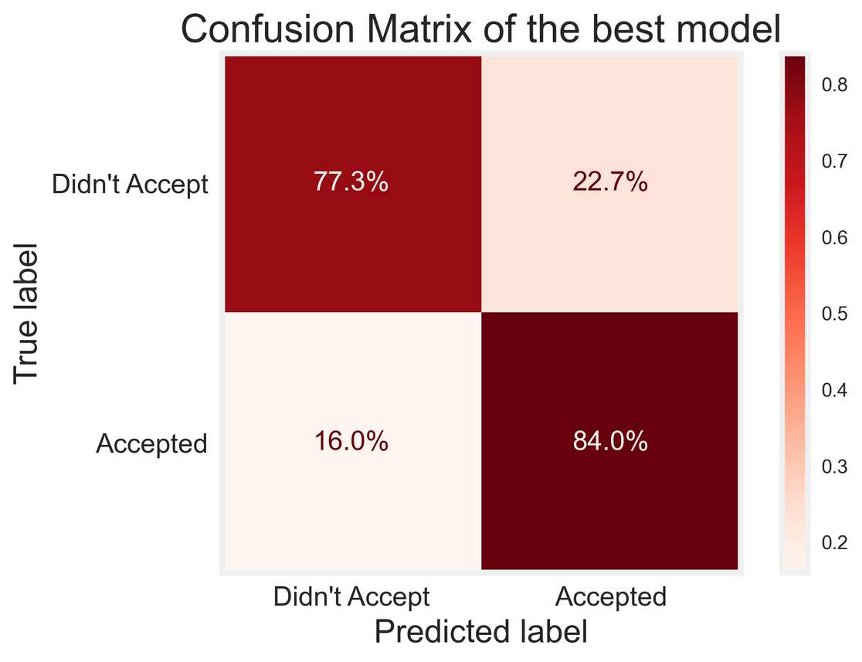
MODEL'S PERFORMANCE
The model does a good job of predicting whether a customer would accept the campaign or not;
The model would correctly predict that 84% would accept the campaign and 77% would not;
The results were obtained from the test set created using a stratified split approach.

Slide 13
PREDICTIVE MODEL STRATEGY
The last approach was to use a machine learning model able to predict if a customer would accept or not the marketing campaign. To evaluate its results the key metrics were calculated using a test set that had a similar ratio of respondents and non-respondents as the entire dataset, 15%, and 85% respectively.
ENTIRE TEST SET
HIGHEST
-45%
-0.03%
44%
RETURN ON INVESTMENT (ROI)
RETURN ON INVESTMENT (ROI)
RETURN ON INVESTMENT (ROI)
15%
39%
SUCCESS RATE
SUCCESS RATE
Only 15% of customers contacted accepted the campaign.
27%
Only 39% of customers contacted accepted the campaign.
SUCCESS RATE
672
214
Only 27% of customers contacted accepted the campaign.
CUSTOMERS CONTACTED
CUSTOMERS CONTACTED
89% ROI IMPROVEMENT OVER THE LAST CAMPAIGN!

Slide 14
NEXT STEPS!
TRY A MANUAL RFM SEGMENTATION USING MARKETING TEAMS KNOWLEDGE AND INSIGHTS;
ASSESS THE USE OF MORE COMPLEX ALGORITHMS LIKE TREE BASED CLASSIFIERS, XGB BOOSTING FRAMEWORK, AND DEEP LEARNING TECHNIQUES.

Slide 15
ANY QUESTIONS?
l.meireles.murtha.oliveira@gmail.com
https://github.com/leoMurtha

